Slide 1
ASRJC-NTT High School Online Exchange Programme
Notes:
Script: A very good afternoon to our guests from Nguyen Tat Thanh High School and fellow ASRJCians! Welcome to the ASRJC-NTT High School Online Exchange Programme!
(Note: It will be good to say the exchange school’s full name at first introduction if possible. Do get pronunciation right.)

Slide 2

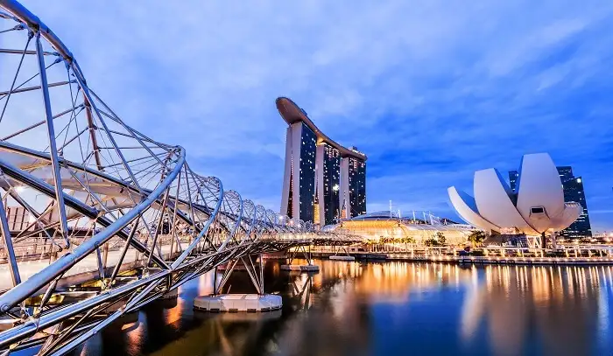
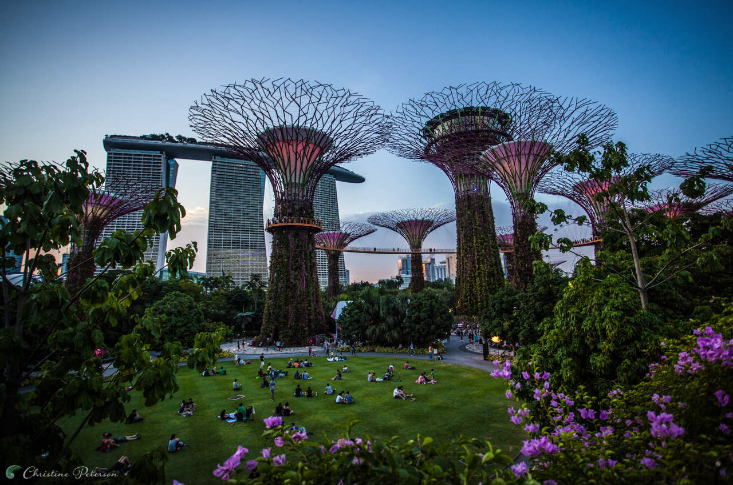
Hello there!
We are Jannah, Ruth, Hao, Adhithyaa and Mai,
your hosts for today!
Notes:
Script:

Slide 3
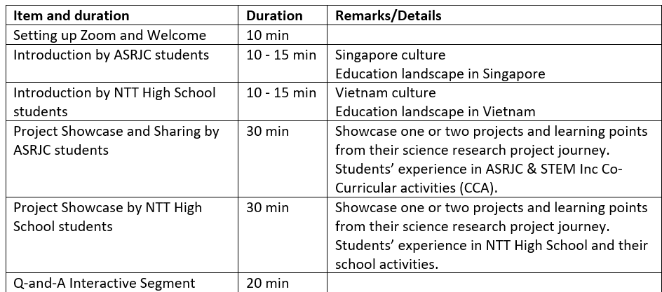
Today’s flow of events
Notes:
Script: This is our flow of events for today. We look forward to a rich exchange between both schools through sharing on the culture, education landscape, school experience as well as project showcase. We will end off the day with a Q&A segment for all participants.

Slide 4
Today’s sharing
Our heritage: Singapore’s Culture and her hidden gems
Our education system:
What’s it like as a Singaporean student
Our personal experience: ASRJC and STEM Inc.
Project Showcase
Notes:
On behalf of ASRJC, we would like to begin the exchange by first sharing with you about Singapore’s Heritage and Education System by Ruth, Jannah and Hao.
We will then handover the time to NTT High School before we continue with second segment of our sharing on our personal experience and project showcase.
Without further ado, I’ll pass the time to Ruth and Jannah.
(Side note: Do try to keep this short as it is somewhat overlap of the previous slide)

Slide 5


What impressions do you have of singapore?
ⓘ Start presenting to display the poll results on this slide.
Notes:
📣 This is Slido interaction slide, please don't delete it. ✅ Click on 'Present with Slido' and the poll will launch automatically when you get to this slide.

Slide 6
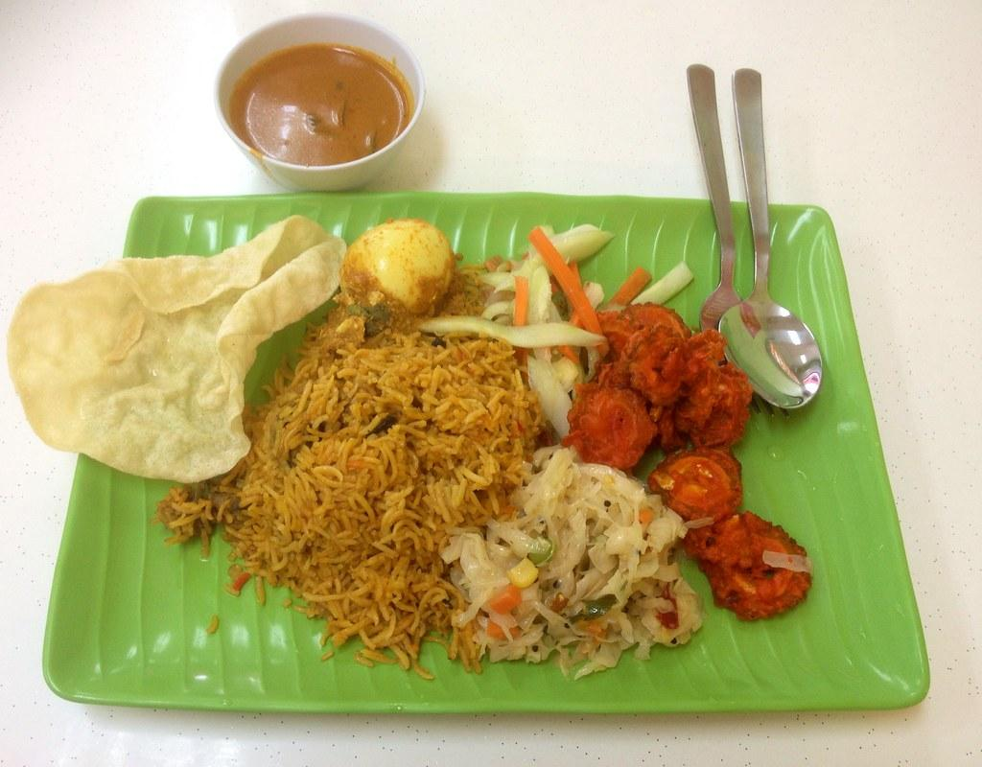

Our heritage: Singapore’s Culture and her hidden gems
Places of interest and popular delicacies

Slide 7
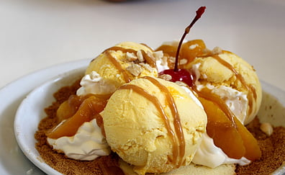
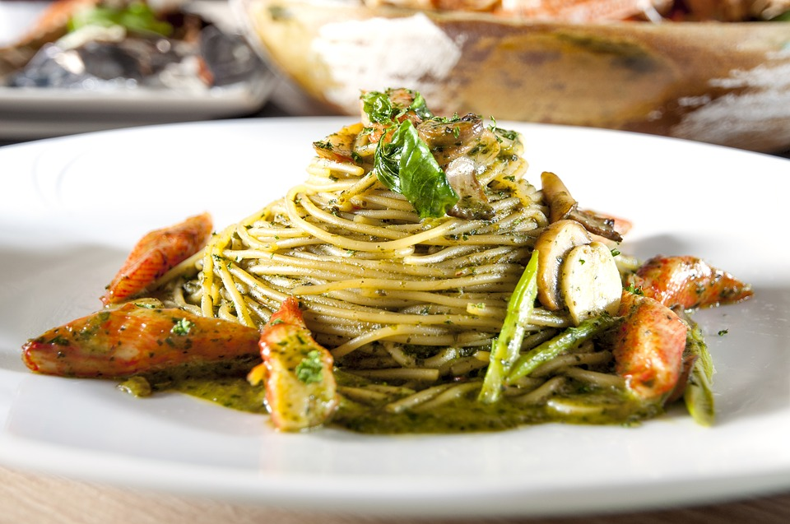

Singapore’s delicacies; the symbol of harmony
Singapore is well known for her food, we have a variety of dishes from different cultures such as Hainanese chicken rice, Briyani and Chendol
However, what makes Singapore special are fusion foods
Eg. Seafood laksa pasta and Pisang goreng Crème Brûlée
A symbol of harmony and collaboration between the different cultures!
Pisang goreng Crème Brûlée
Seafood laksa pasta
Notes:
Fusion foods that incorporate aspects of dishes from different cultures to create a whole new delicacy
Pisang goreng creme brulee-> Pisang goreng which means “fried banana” in Malay is commonly eaten among Singaporeans and Malaysians. Creme Brulee is a vanilla custard dessert originating from France. The custard is topped with sugar on top. Together, they form a Pisang Goreng Creme brulee dessert topped with ice-cream and drizzled with caramel sauce. An ideal dessert for banana lovers.
Seafood Laksa Pasta -> Laksa is a peranakan food composed of noodles and a coconut based gravy. It is accompanied with toppings such as fishcakes, beansprouts and clams. Pasta is an italian dish and there are many versions of it. What makes Seafood laksa Pasta special is that the gravy aspect of Laksa is removed and it becomes a spice for the seafood.

Slide 8
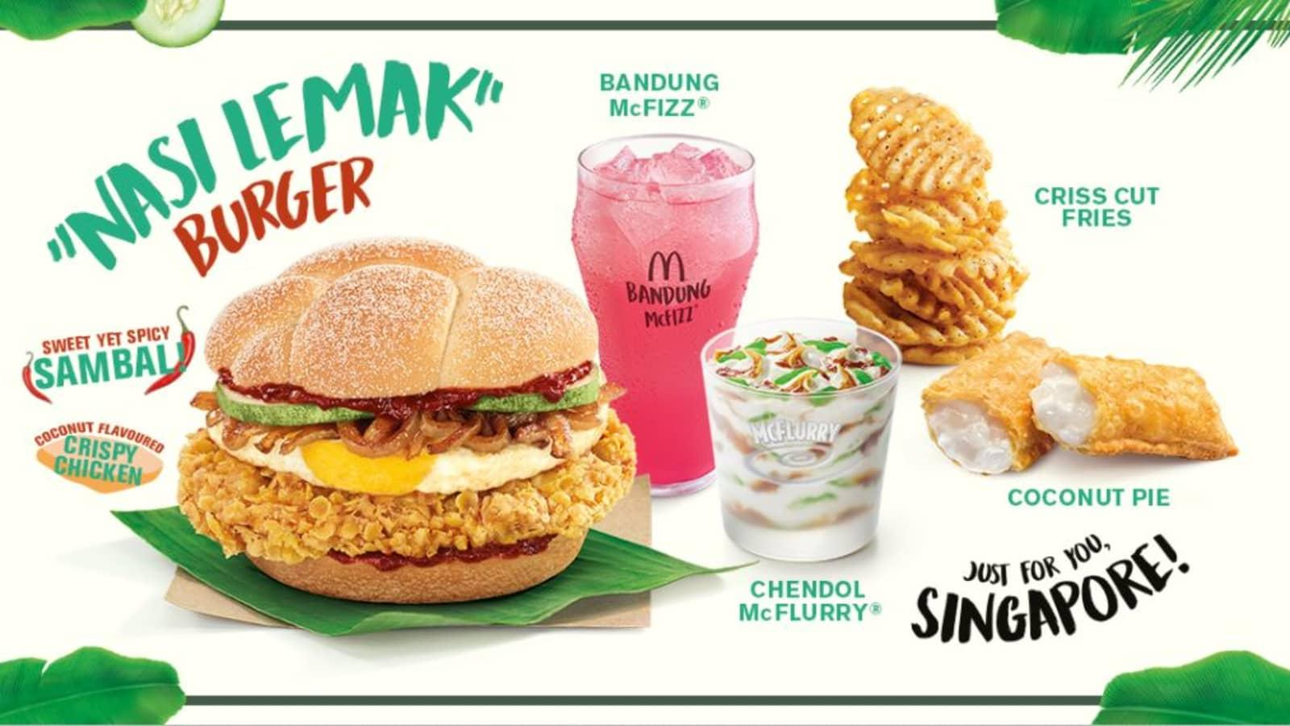
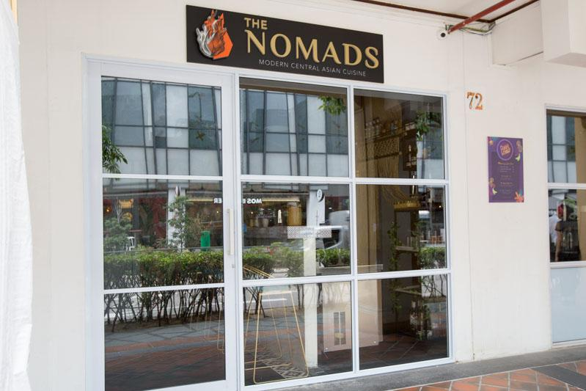
Restaurants and fusion foods
Nasi Lemak Burger Mcdonald
One of the best selling burgers, exceeding Mcdonald’s expectations
It features semolina buns served with coconut-flavored fried chicken thigh, egg, caramelized onions, cucumber and sambal.
The Nomads SG
Sells diverse foods unique to Asia, from the streets of Southern Italy to China, and Kazakhstan.
Notes:
Nasi Lemak burger -> Nasi lemak is a rice dish from Malaysia. The savoury dish involves a fried chicken thigh, slices of cucumber, a fried sunny up egg, pieces of ikan bilis also known anchovies, fragrant rice and dolled with spicy sambal. Mcdonald usually
It is interesting to see how foods such as rice and burger which varies so significantly can be fused together to create an entirely new concept
The Nomads reflect a nomadic journey across an ancient food trail

Slide 9
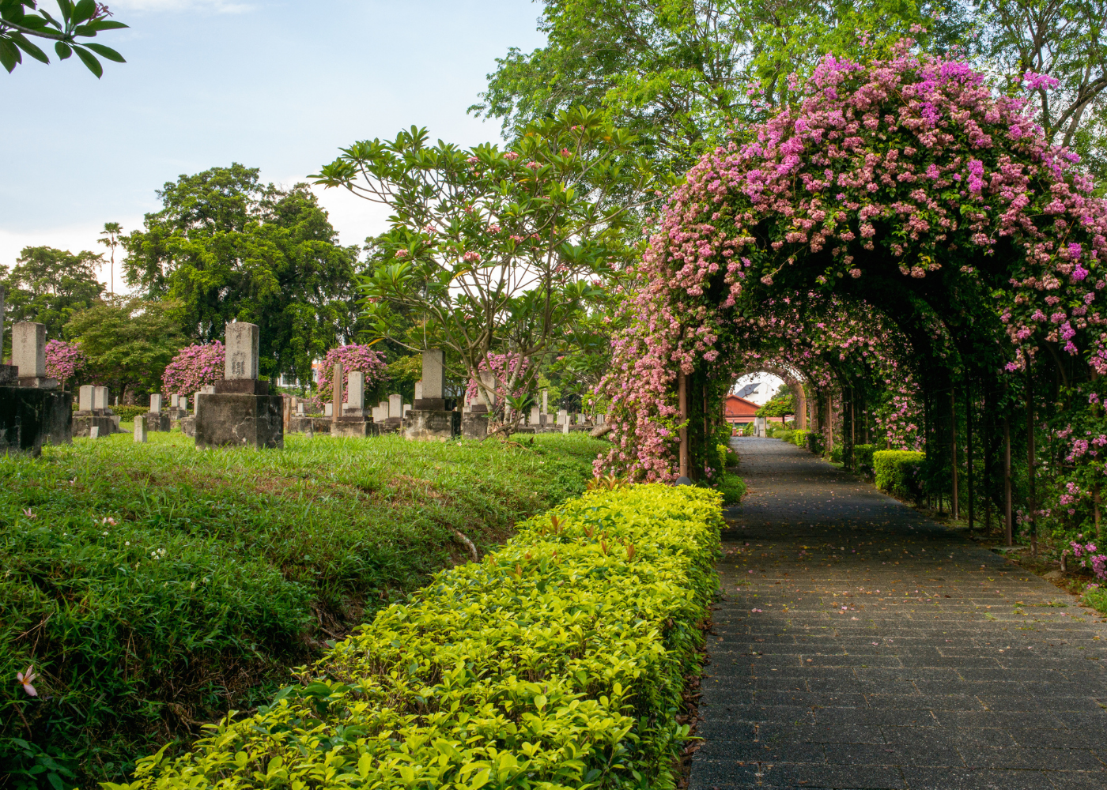


Hidden gems of Singapore
Built in 1891, the Japanese Cemetery Park (the largest in Southeast Asia) is tucked away in Hougang. Serving as a burial ground for nearly 1,000 Japanese civilians and soldiers from pre-war years, this hidden place has strangely turned into one of Singapore’s IG-friendly spots.
Address: 22 Chuan Hoe Avenue, Singapore 549854
At the tip of the Raffles Marina club’s breakwater stands the Raffles Marina Lighthouse, overlooking Tuas Second Link. It’s still in operation and flashes every 10 seconds with a beam that reaches up to 15 metres. Built in 1994, this 12-metre-high structure is the only lighthouse in Singapore that is owned and maintained privately. It’s open to the public for visits for free.
Notes:
First, we have the japanese cemetary park. It was build in 1891 and is home to about one thousand japanese civillians and soldiers from before ww1.
Next, the raffles marina lighthouse stands proud at the tip of tuas. Built in 1994, it is now the only privately owned lighthouse in singapore. Entrance to the lighthouse is free and opened to the public!

Slide 10
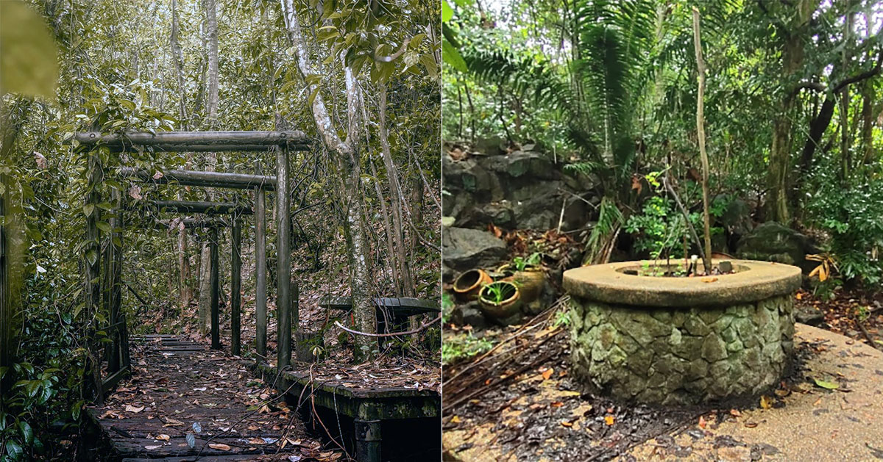
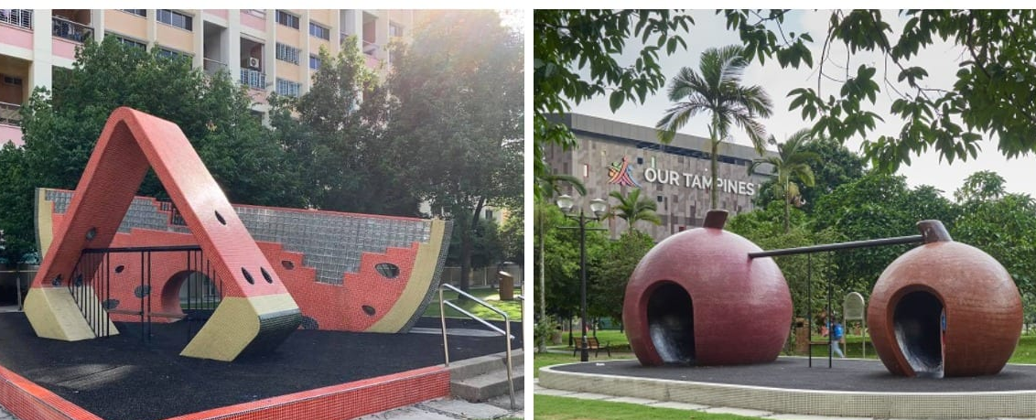
Hidden gems of Singapore
At Bukit Batok Hillside Park, there are wooden structures resembling Japan’s distinctive torii gates. They appear to be remnants of a covered walkway.
Address: 1 Bukit Batok West Ave 2, Singapore 659203
Creatively shaped like a slice of watermelon, the playground structures are decorated with red, white (or yellow) and green mosaic tiles to resemble the flesh and skin of a watermelon. There are also holes on the walls to represent the melon seeds.
Address: Tampines Central Park, Tampine Street 83
Notes:
Thirdly, we have bukit batok hillside park. This park contains wooden structures resembling japans distinctive torii gates, appearing to be remenents of a covered walkway. The park is now considered “abandoned” and gives a vastly different experience from singapores other nature parks.
Finally, tampines central park has a playground that is built creatively with shapes like watermelon. It is reminiscent of our parents and grandparents pasts as they grew up in these types of playgrounds.

Slide 11
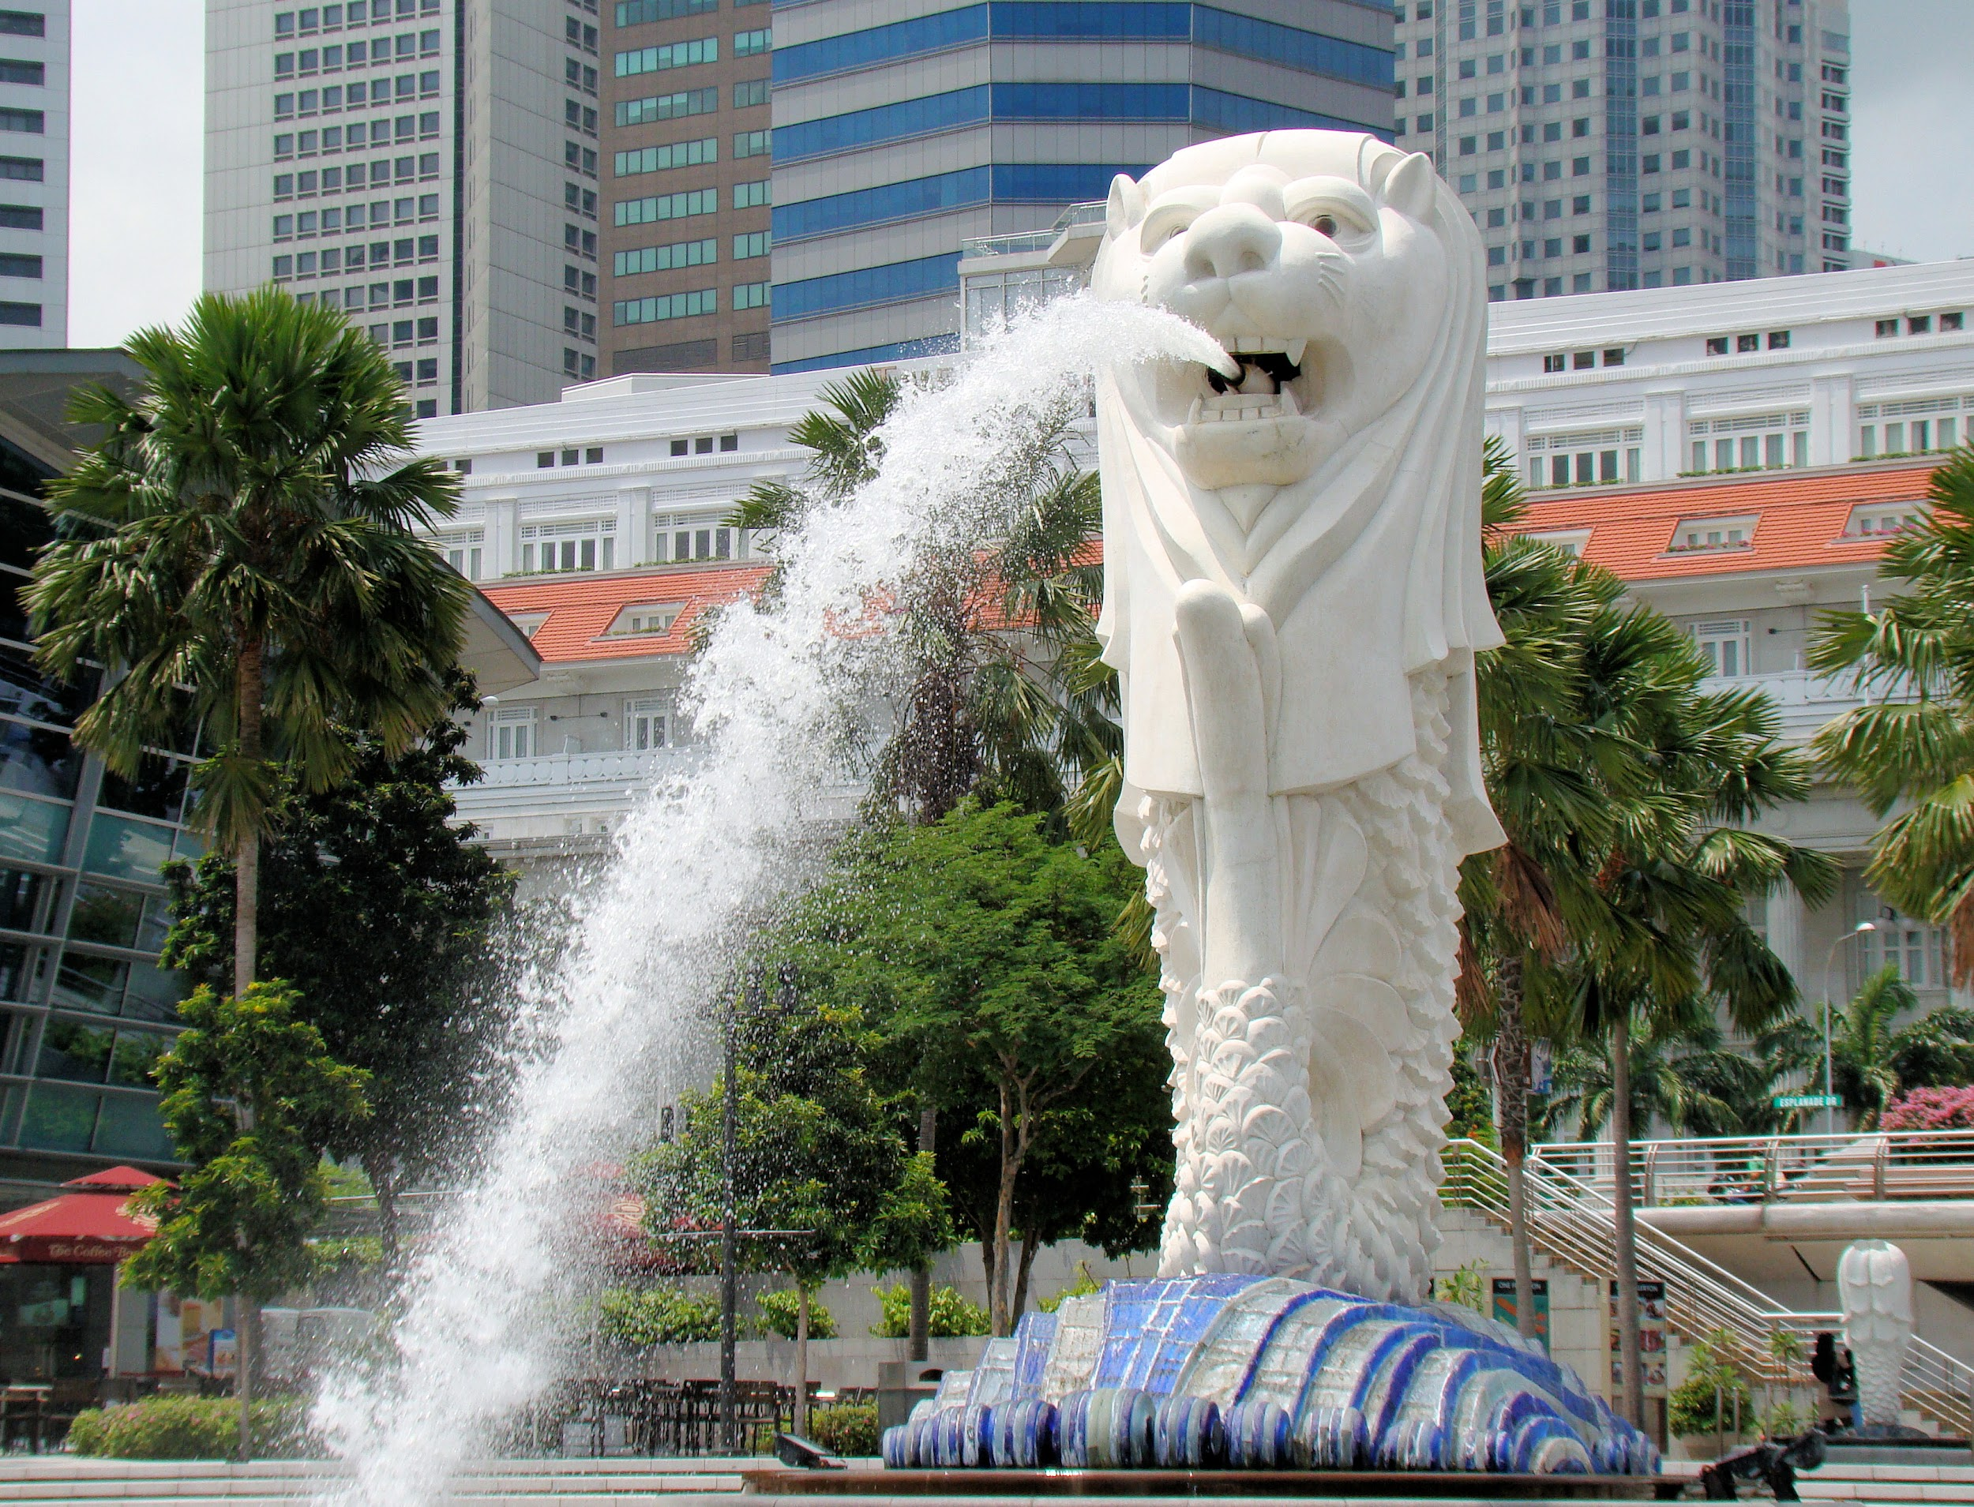
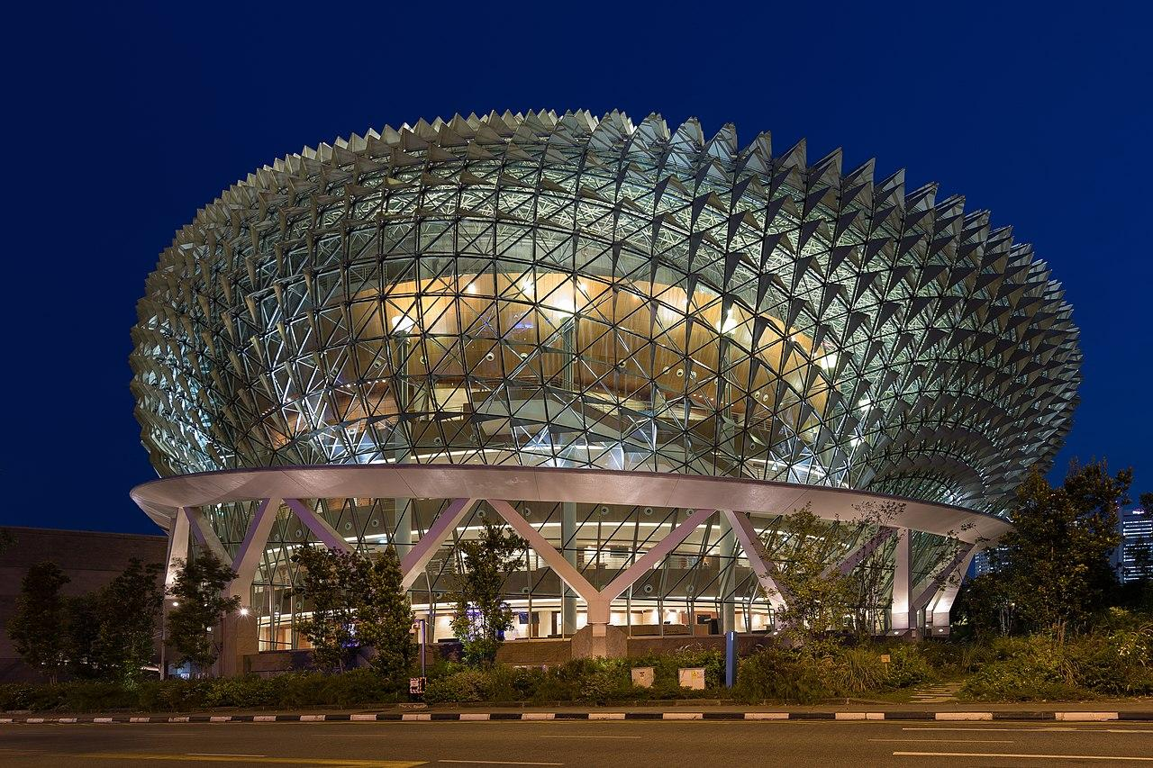
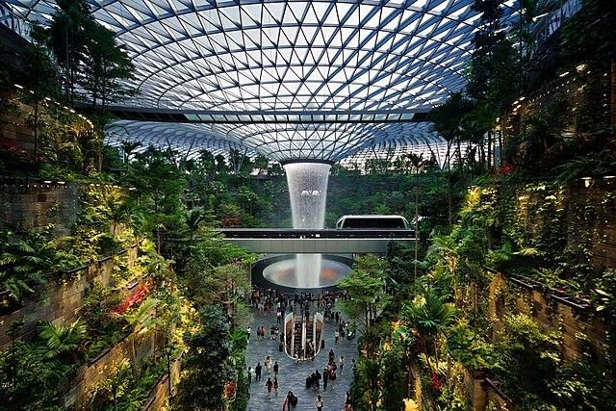
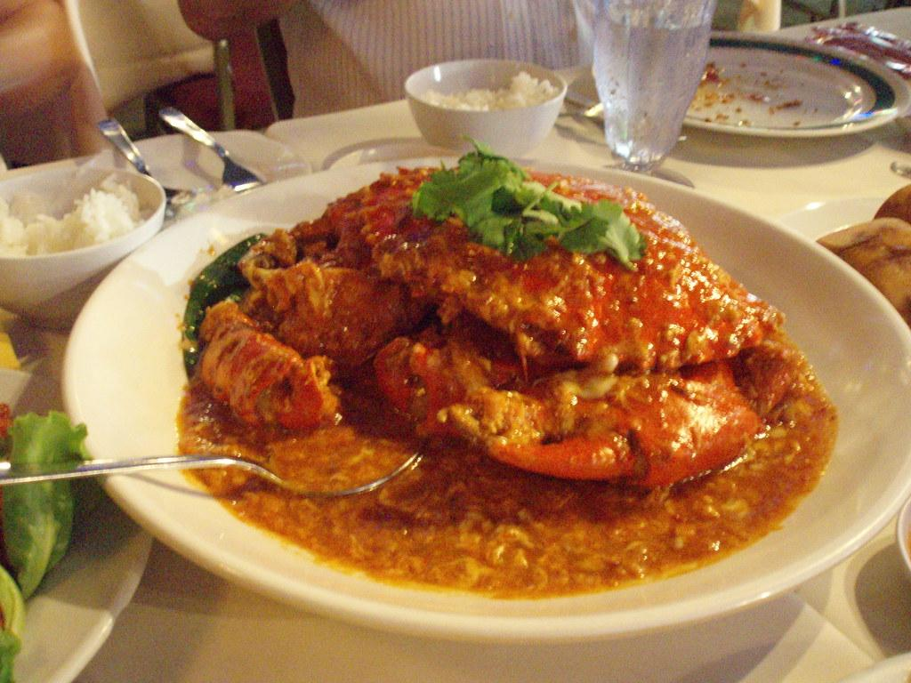
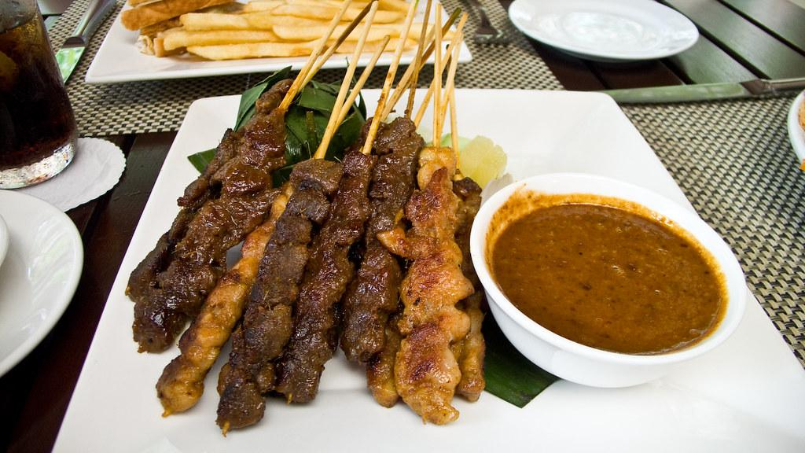
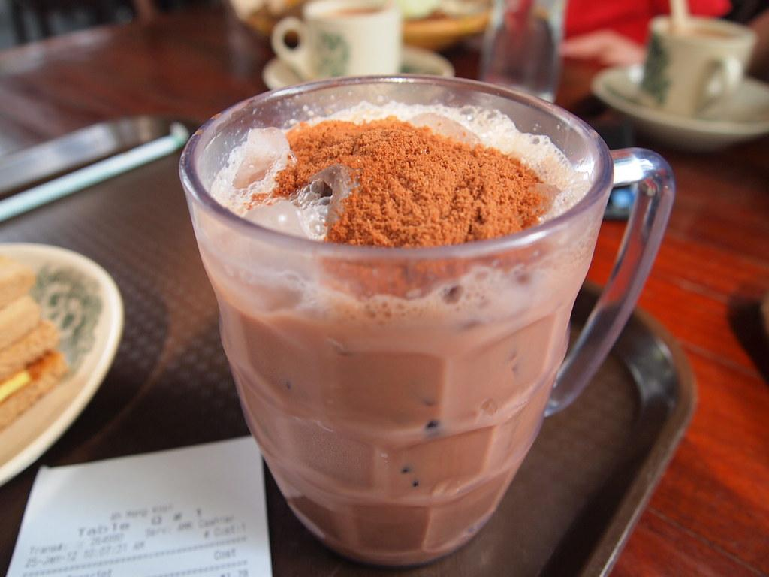
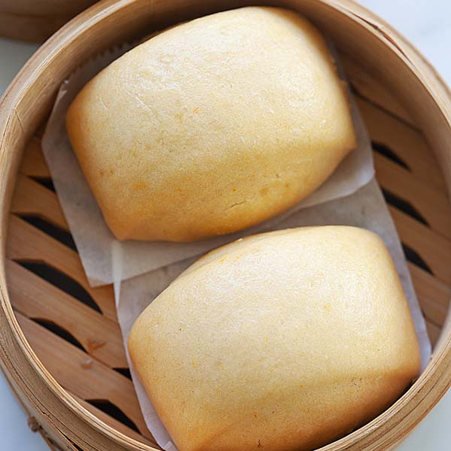
Some iconic Singaporean places and foods you may know!
Merlion
Esplanade
Jewel, Changi airport
Milo dinosaur drink
Chilli Crab
Satay
Notes:
Merlion -> The icon of Singapore. There are many merlion statues in Singapore
Esplanade -> an art theater modelled after the Sydney Opera House. It resembles a durian too
Jewel Changi Airport -> A water vortex can be found within the airport itself along with a variety of shops selling goods ranging from luxurious goods to food
Chilli Crab -> boiled crab in a chilli sauce, usually served with mantou (a chinese steamed bun)
Satay -> Satay is a meat skewer (usually chicken, mutton or beef) served with a peanut gravy sauce
Milo Dinosaur -> milo dinosaur is a popular drink in singapore. It is the basic milo with a twist: a spoonful of pure milo powder on top of the drink.

Slide 12
Our education system
Notes:
Next up will be Hao, who’ll be sharing more about the Singapore education system.

Slide 13
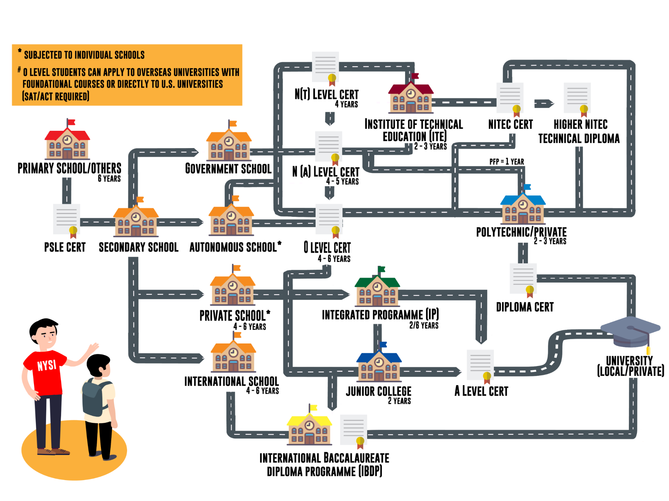

How did we become JC students?

Slide 14
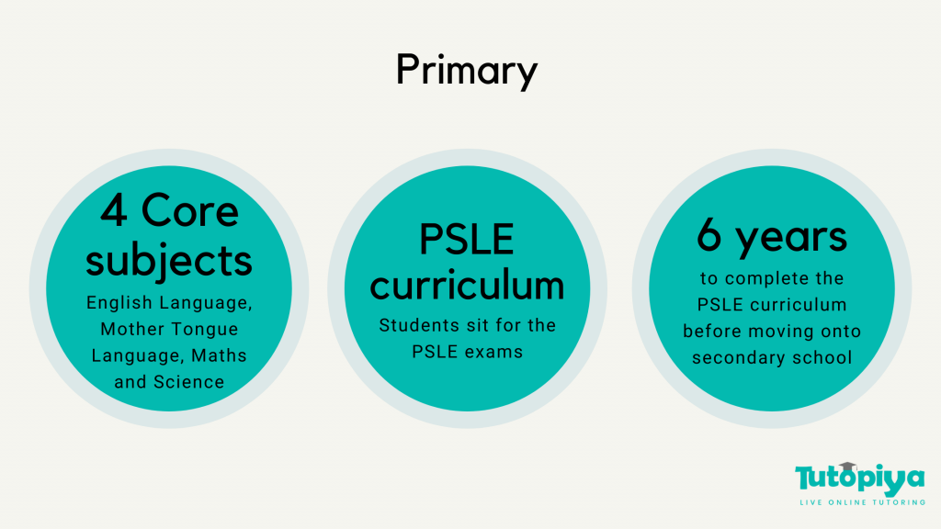
Primary & PSLE (Primary School Leaving Examination)
https://youtu.be/0A56uOVluNM
Notes:
In sg, it is compulsory for all p6 students to go through a major examination before they graduate from Primary School.

Slide 15
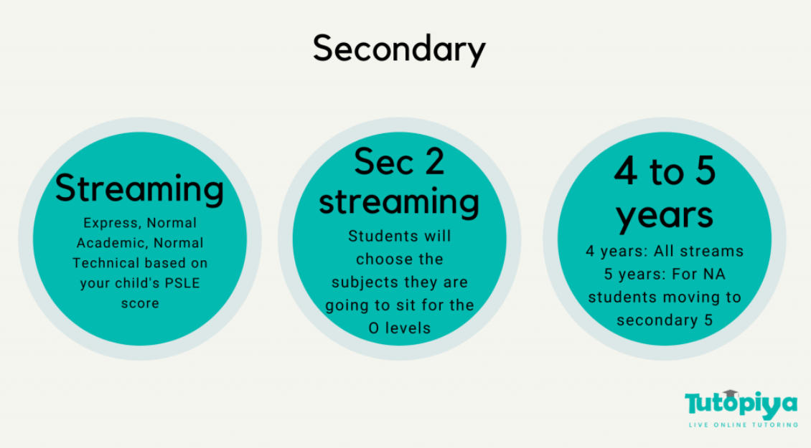
Secondary & O-Level examination
Notes:
There are 3 possible routes for secondary, express, normal academic and normal technical depending on your PSLE scores and choice. Thus, secondary education can take 4 to 5 years, depending on your stream of choice. At the end of sec2, you will get to choose what subject you want to take for your next two years, and thus your O-Level exams.
O-Level exams test knowledge from both sec3 and sec4 equally, so it is very demanding and one has to study very hard to score well.

Slide 16
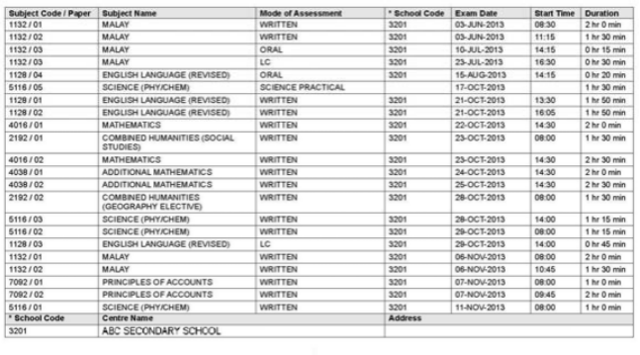
O-Level examination
Notes:
Science: 3 papers (Practical, Theory, MCQs)
English & MTL: LC,C,W,S
Humanities: Social Studies (compulsory) + Elective Geography/History/Literature or Pure Humanities
Art: Work on a 9-month long project + Drawing & Painting paper

Slide 17
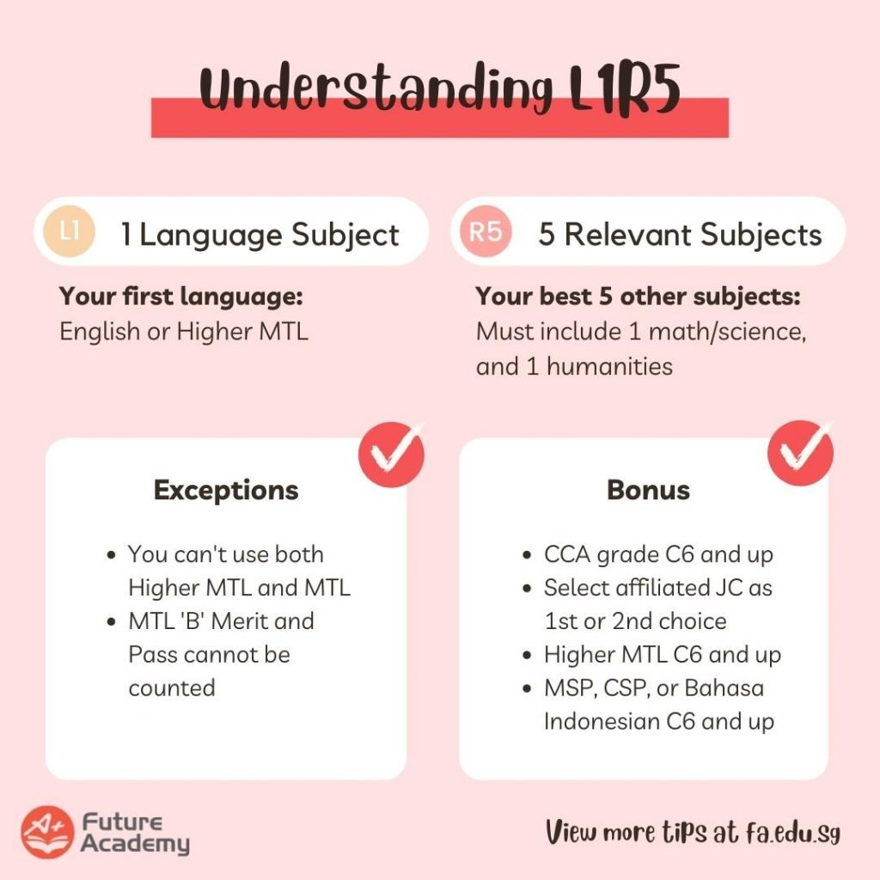
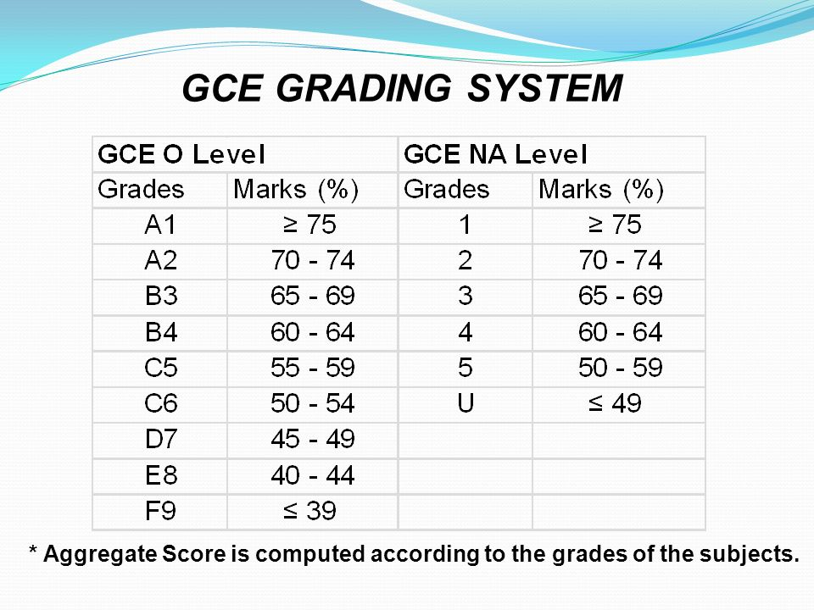
L1R5 scoring system
Notes:
O Level has a unique scoring system that doesn’t allow a student to be inclined towards a certain group of subject.
Based on your score on the paper, here is the score-grade conversion.
This grade will add up to give you your final L1R5 scores, which has to include at least 1 language subject, 1 humanities subject and 1 science subject.

Slide 18
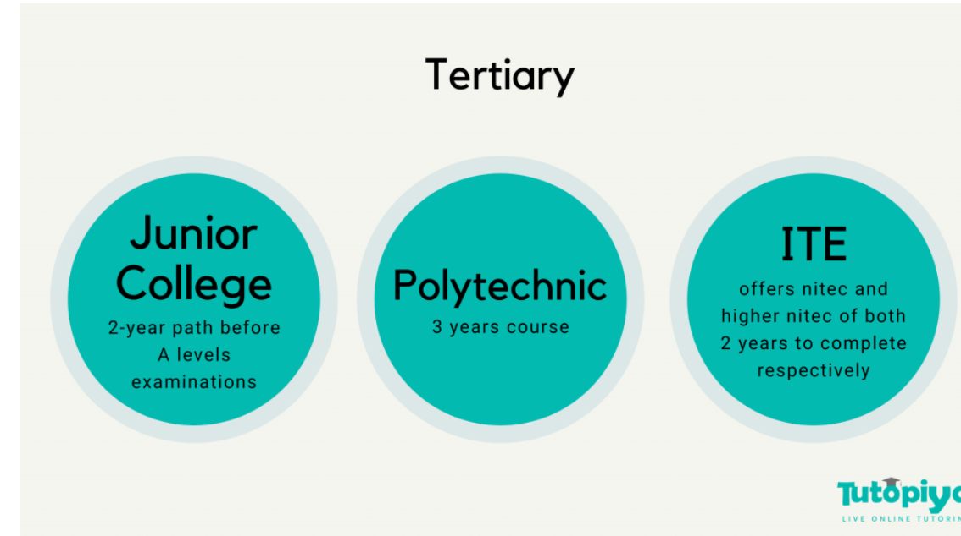
Tertiary Education

Slide 19
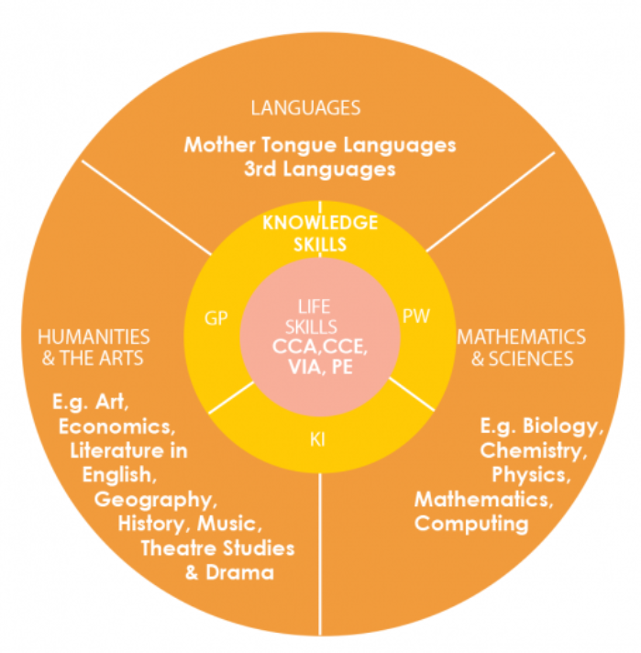
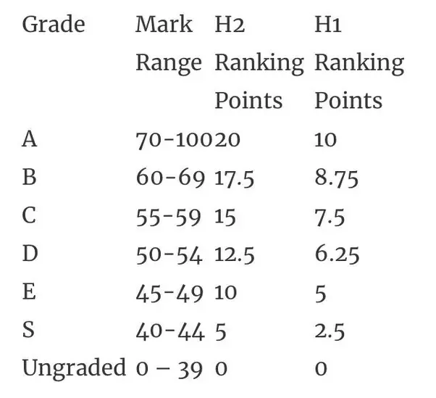
A-Level examination
Grading system
Subject group
Notes:
4 subject groups: languages, knowledge skills, math&sci, humans
You can choose to take a subject in either Higher 1 level or Higher 2 level (Higher 3 level is offered only to certain students with exceptional proficiency in the subject).
The A-Level exam also has a rather unique grading system. Firstly, the score of your papers will be computed as per normal (for e.g, 60%,70%,...). This score will then be translated into a grade (>70% = A, >60% = B,...), and this grade, depending on the level you chose, will give you a final rank point for that subject. You must take 3-4 H2 subjects, H1 General Paper, H1 Project Work and H1 MTL if you aren’t exempted. This rank point is required for university admission, and is accepted in most countries around the world.

Slide 20
Now we are going to pass the time to our NTT counterparts!

Slide 21

ANDERSON
SERANGOON
Discere Servire - Non Mihi Solum To Learn, To Serve - Not for Myself Alone
Notes:
Thank you NTT for such an amazing performance at the beginning. So refreshing to see the traditional and the modern embrace each other :)
We love hearing all about Vietnam’s wonderful landscape and rich culture, and of course the food looks delicious!

Slide 22


Notes:
flame - true, light and hope
flower - youth & vitality - nurturing
orange - adventurousness & imagination - unbounded by limits
teal - empathy & reliability - school motto

Slide 23
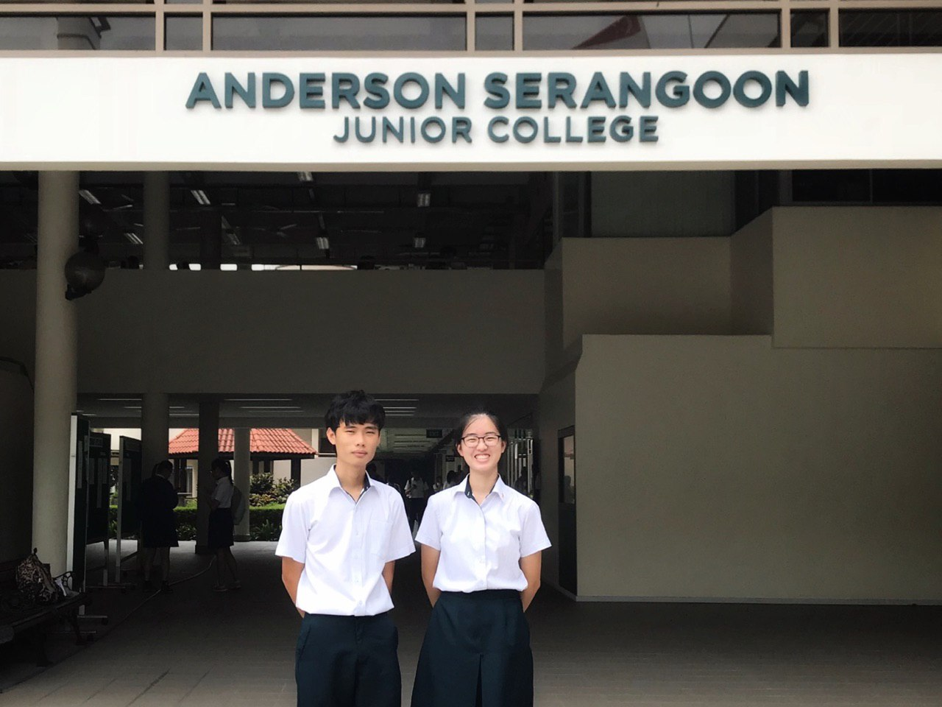
POV: You’re an ASRJCian

Slide 24
 | Off to school!
8.10 | Morning assembly
 | Class Mentor Time
8.30 | Lessons (flexible timetable :0)
 | Lecture + Tutorial
 | Practical
 | Discovery/CCE
After school | Consultation
 | CCA
Notes:
Here are some activities you might see in our daily life at school!
Personally I have to wake up 6 AM, which is definitely not my favorite thing to do. But, I have to anyway, because at 8.10 am we have morning assembly! Then it is Class Mentor Time.
Lessons begin at 8.30 am. We have a flexible timetable, meaning our lessons end at different times, depends on the day and the class. It can be as early as 2pm or as late as 5pm! Our lunch time is also different among classes so we don’t crowd the canteen.
Finishing our study doesn't mean we're finished with school! Either we go for consultations with the teachers, or it's time for CCA!

Slide 25
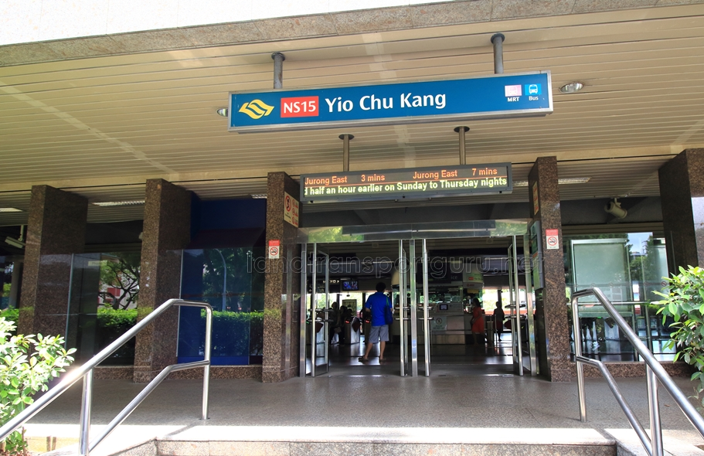
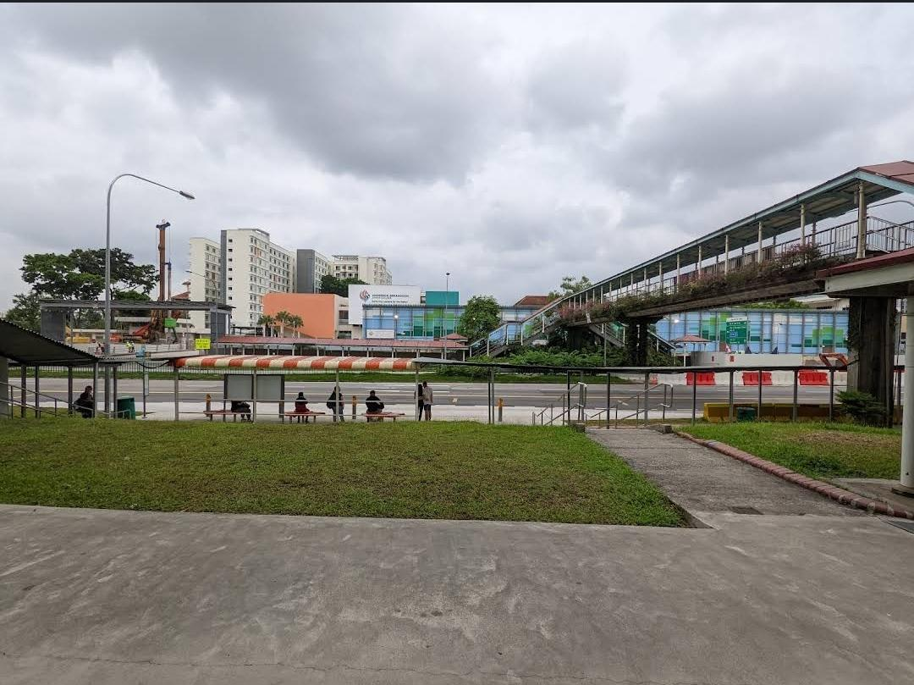
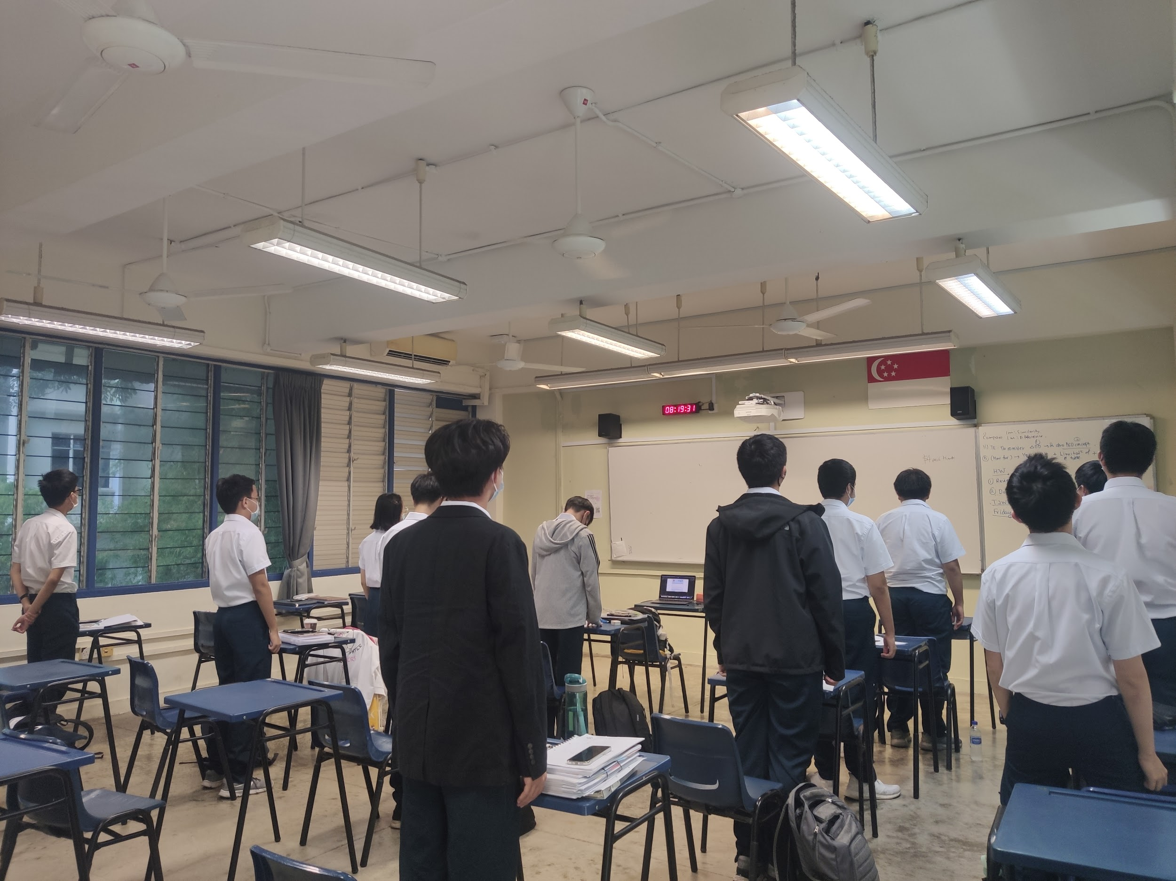
On our way to school~
Morning assembly
+
Class Mentor Time
Notes:
Mai:
On our way to school: most of us take the MRT (Singapore's Mass Rapid Transit) or the bus!
Morning assembly: We sing the National Anthem, the pledge, and the school song
Class Mentor Time: Class Mentor is the teacher in charge of our classroom, who checks in on us every morning and answers our questions regarding administration and class activities

Slide 26
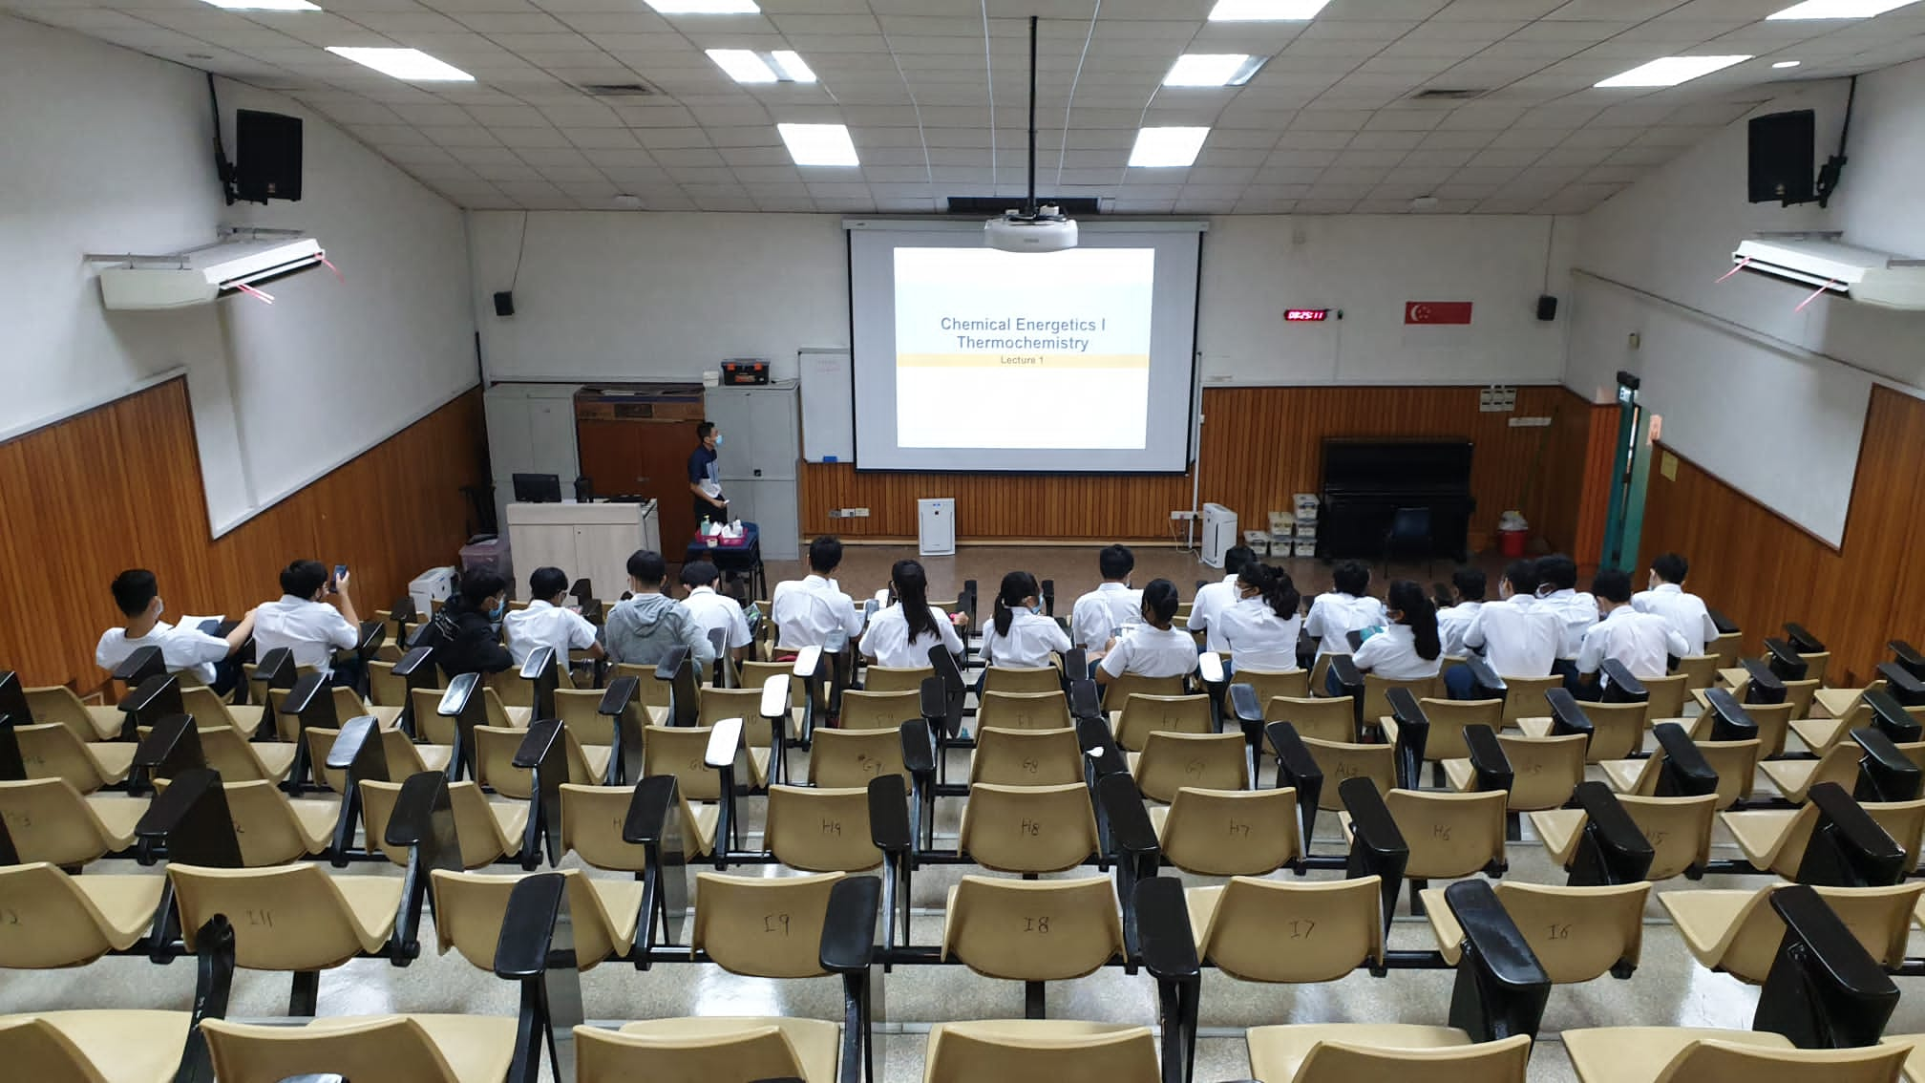
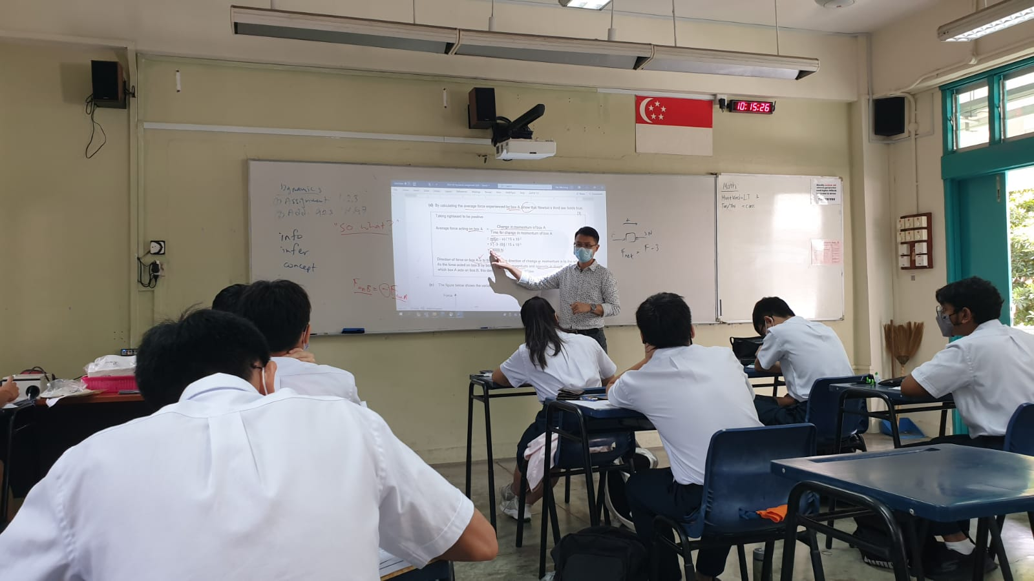
Lesson time
Lectures
Lecture Theatre
Tutorial :0
Notes:
Adhithyaa:
Lectures + tutorial: we have 2 types of usual lessons - lectures (where we learn the theory) and tutorial (where the teachers go through our homework to reinforce our application of knowledge)
Having two distinct types of lessons help us organize our work better, and have more time to correct our misunderstanding on theory or questions on the spot

Slide 27
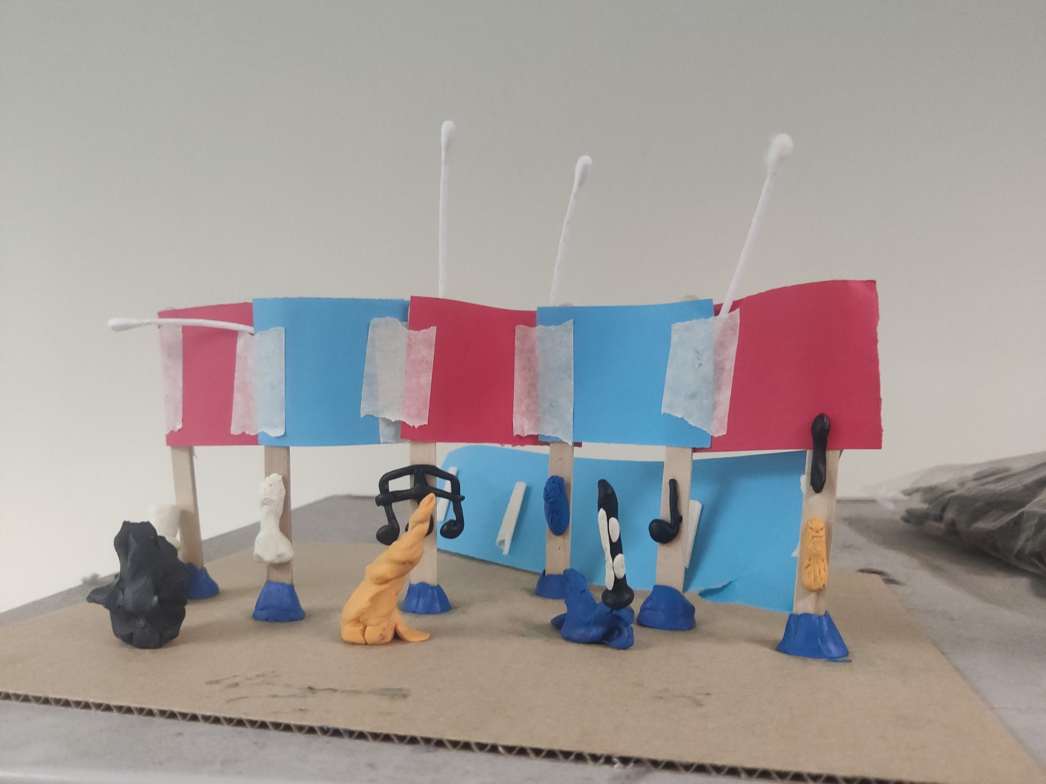
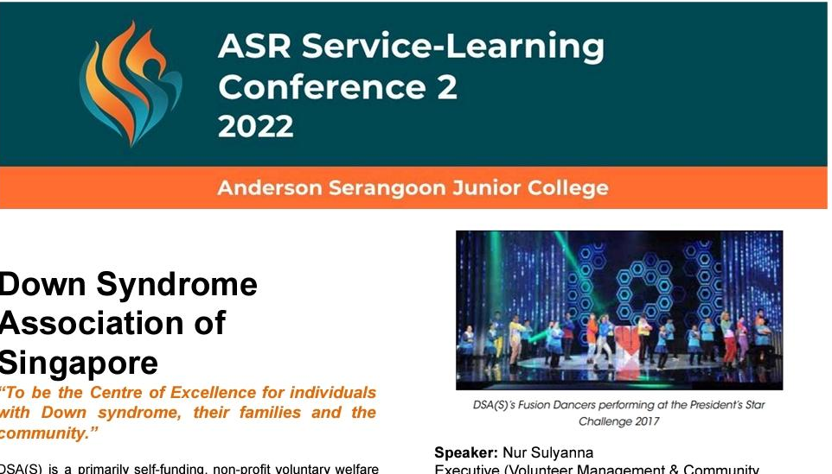
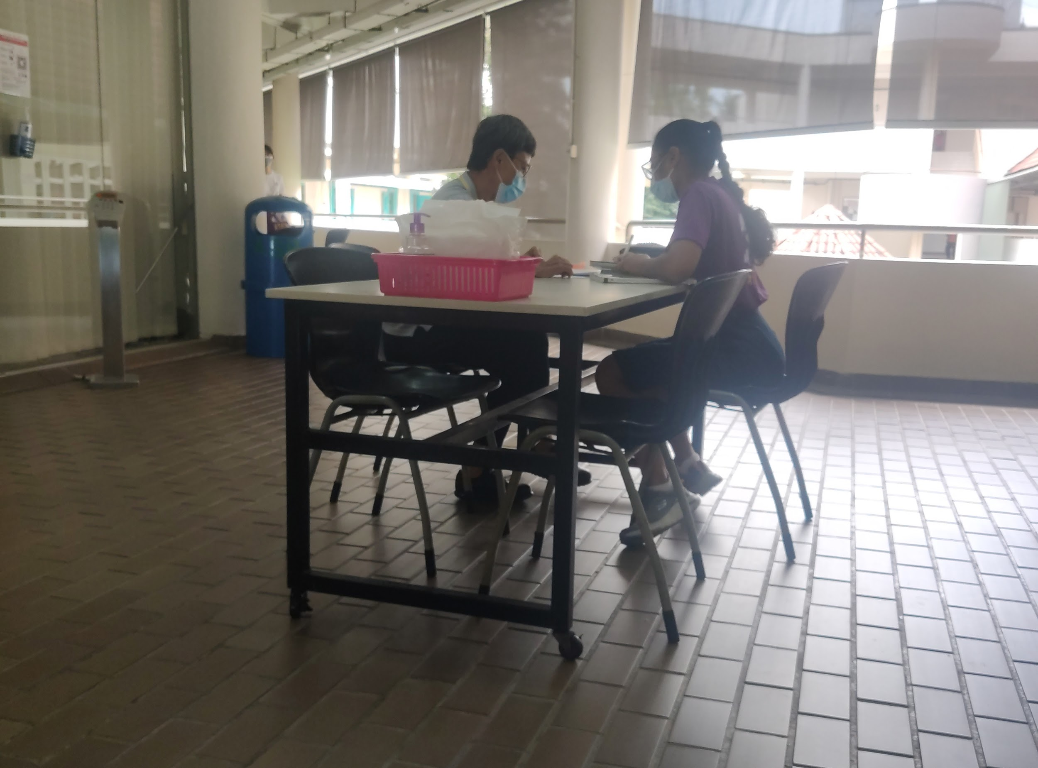
Discovery/CCE
(Character & Citizenship Education)
Consultation
Notes:
Mai:
Discovery/CCE: Our CM will guide on a variety of lessons from scientific discovery, including doing research and making models(this is an idea to incorporate arts and culture in the neighbourhood);
to service learning, where we get to hear about organizations that support people in our community and discuss among our class to plan our own initiatives!
Consultation: Extremely helpful for when you have problem understanding the lessons, or still get stuck on tutorial questions, it is usually one-one, or in a group of 3-4 students

Slide 28
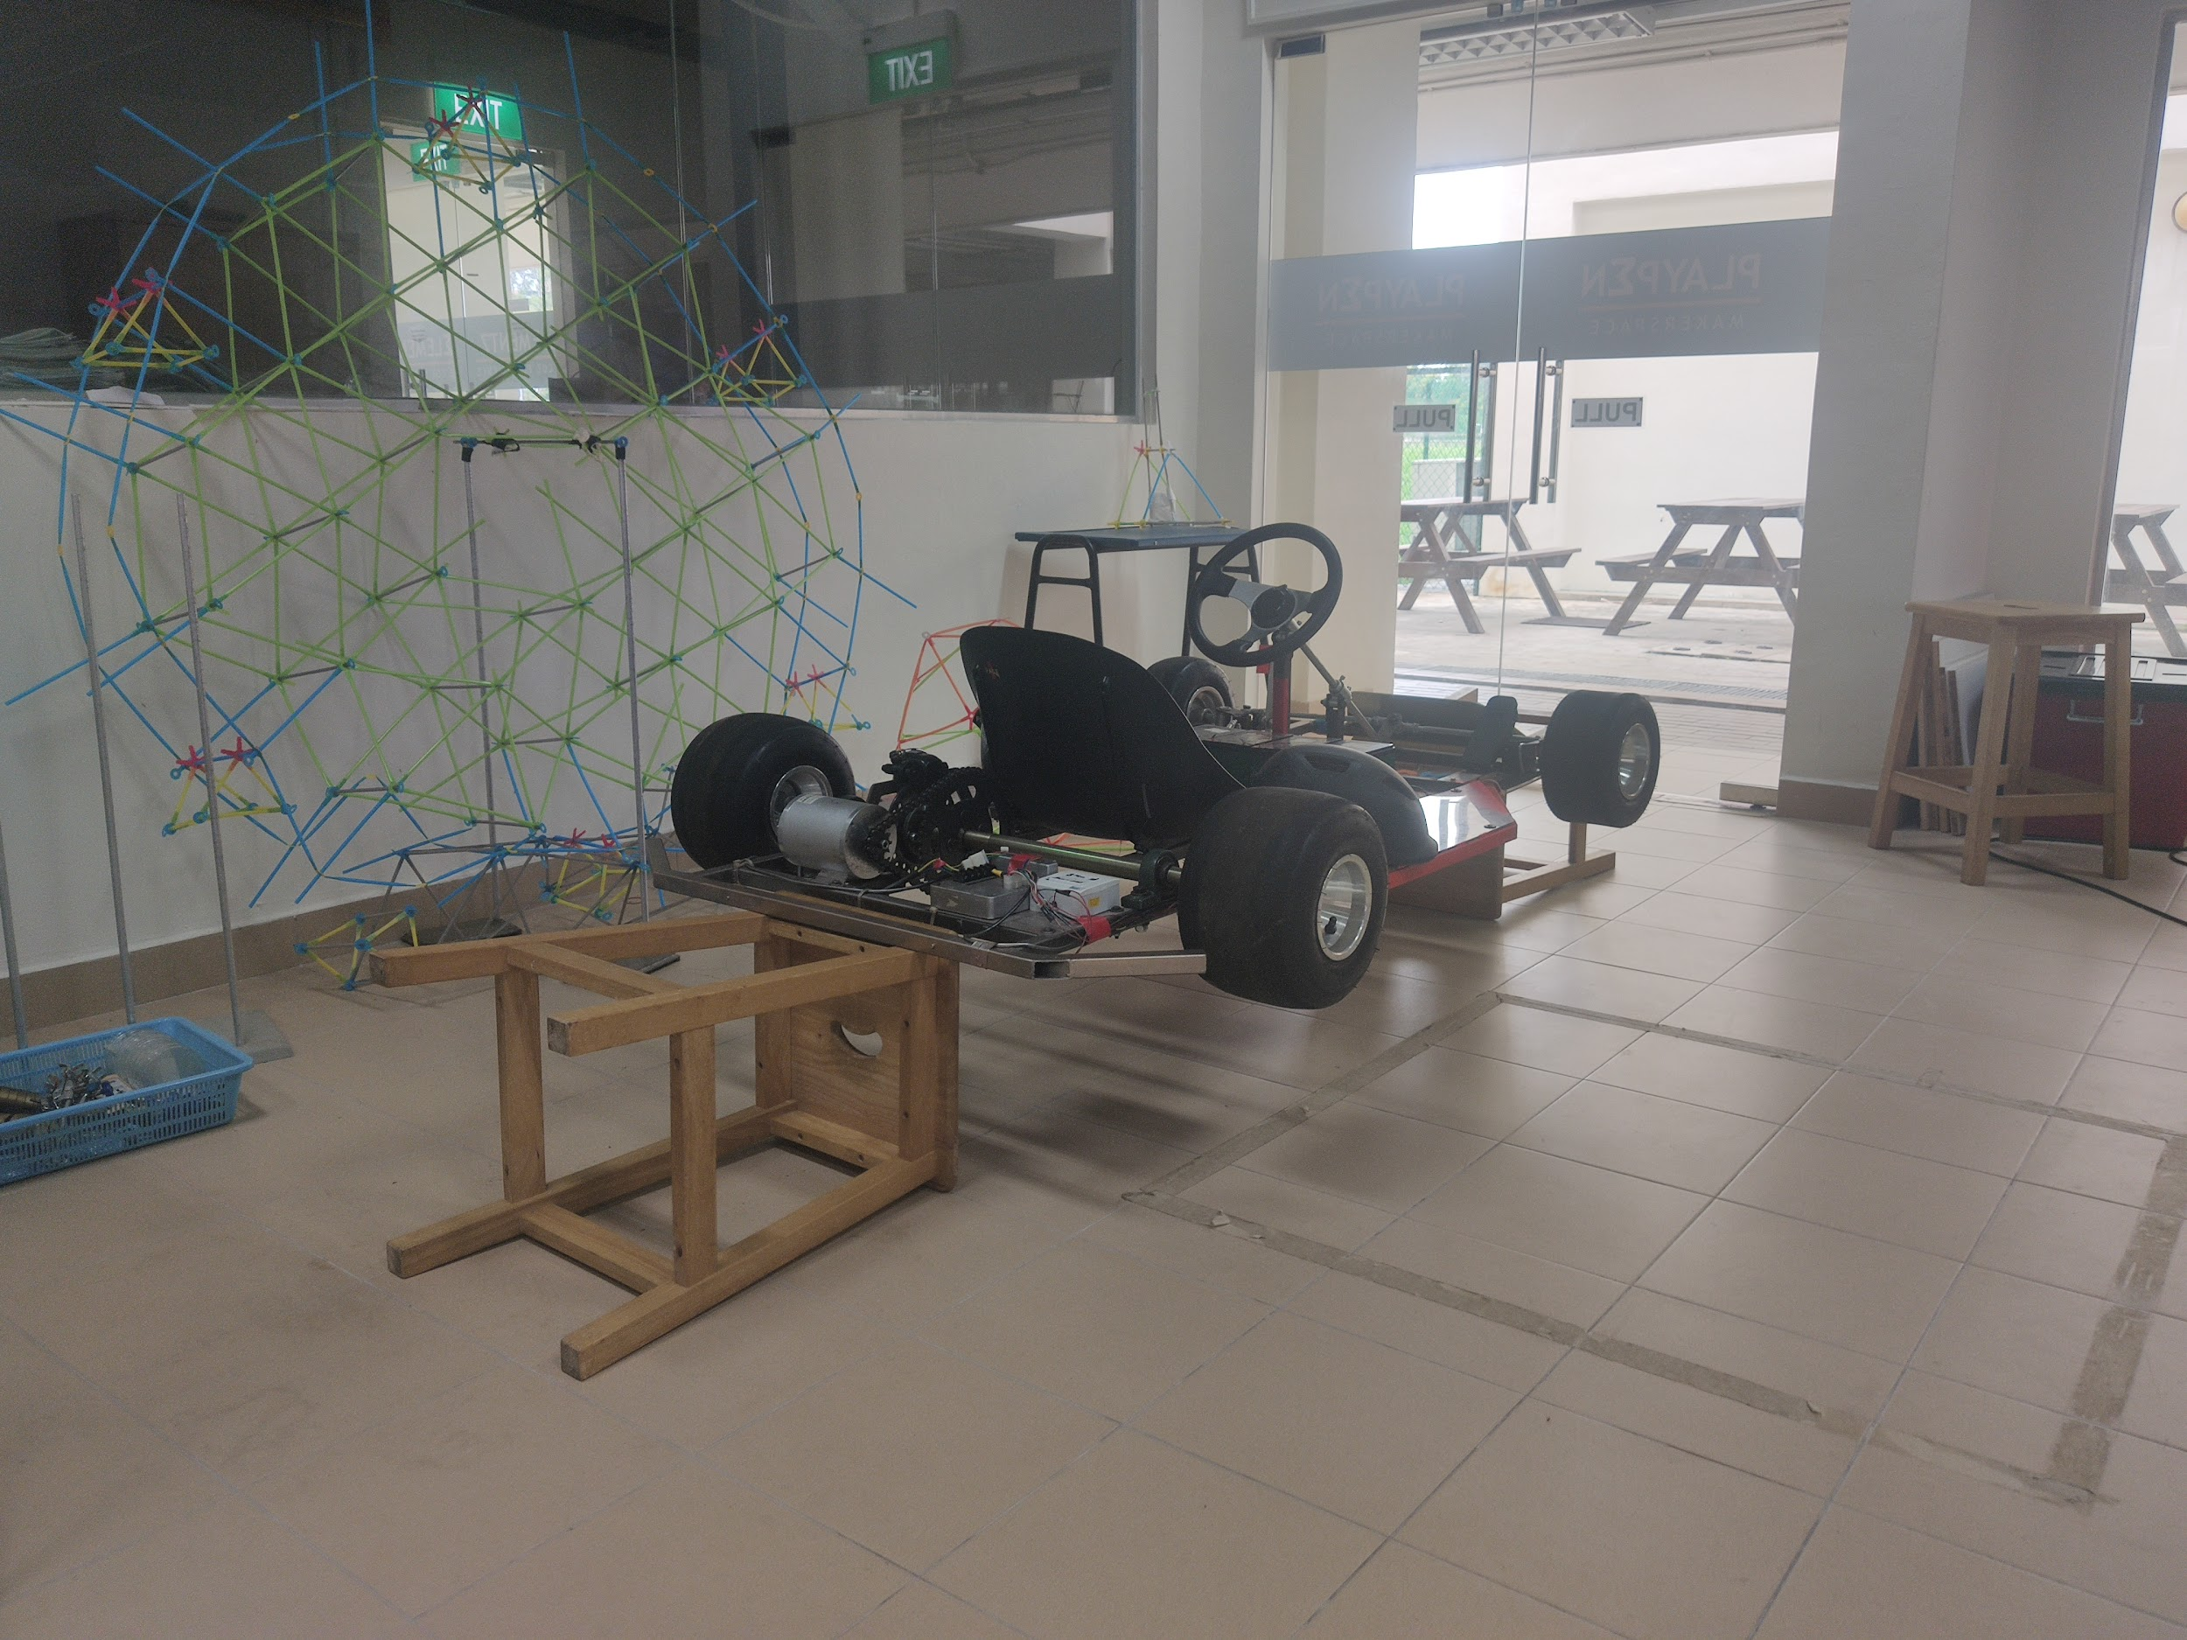
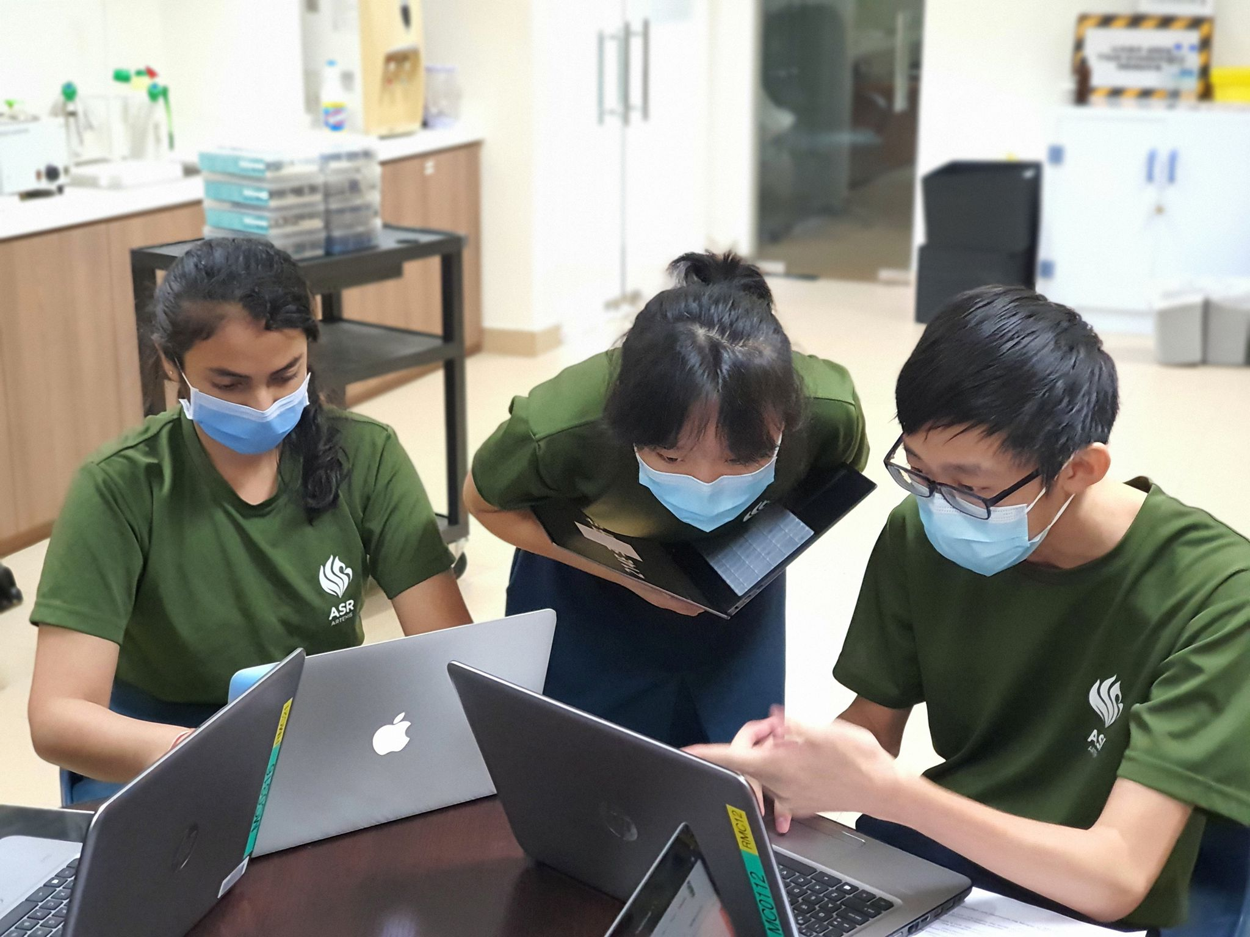
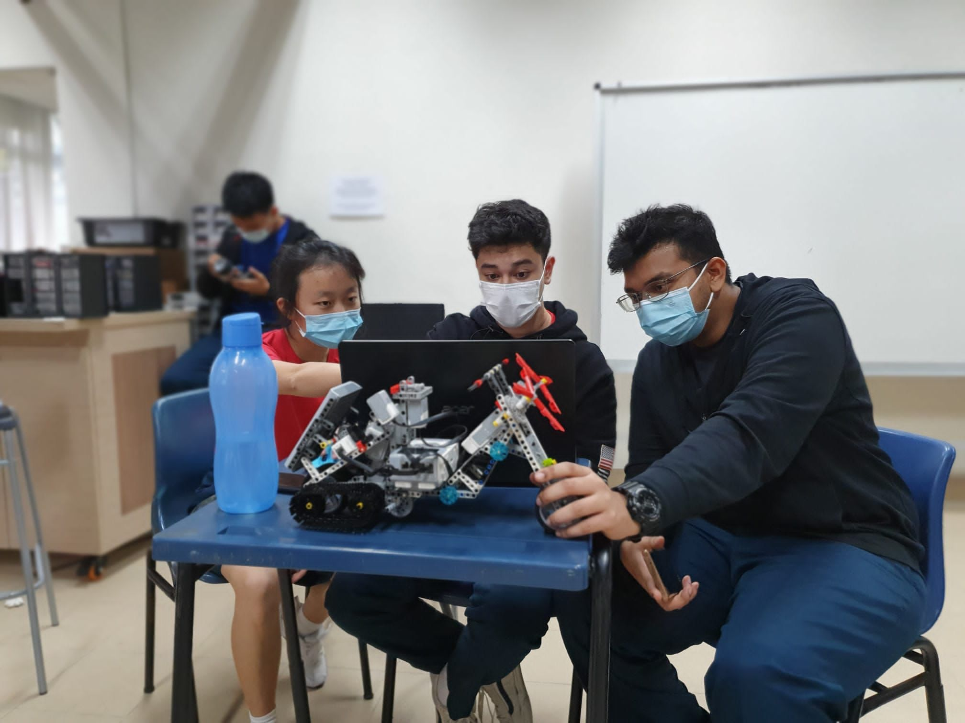
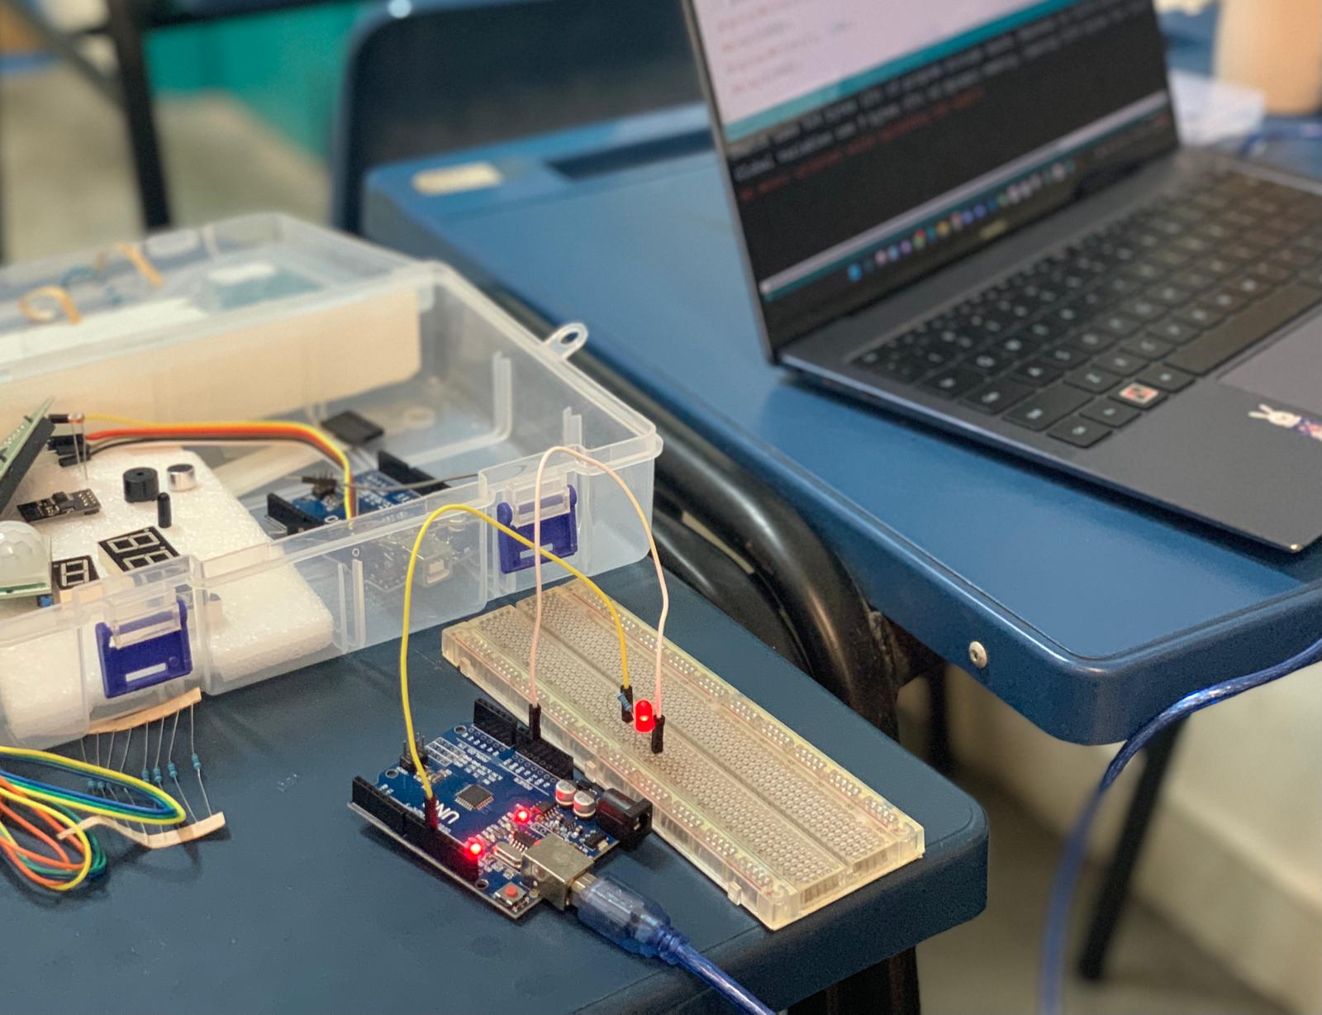
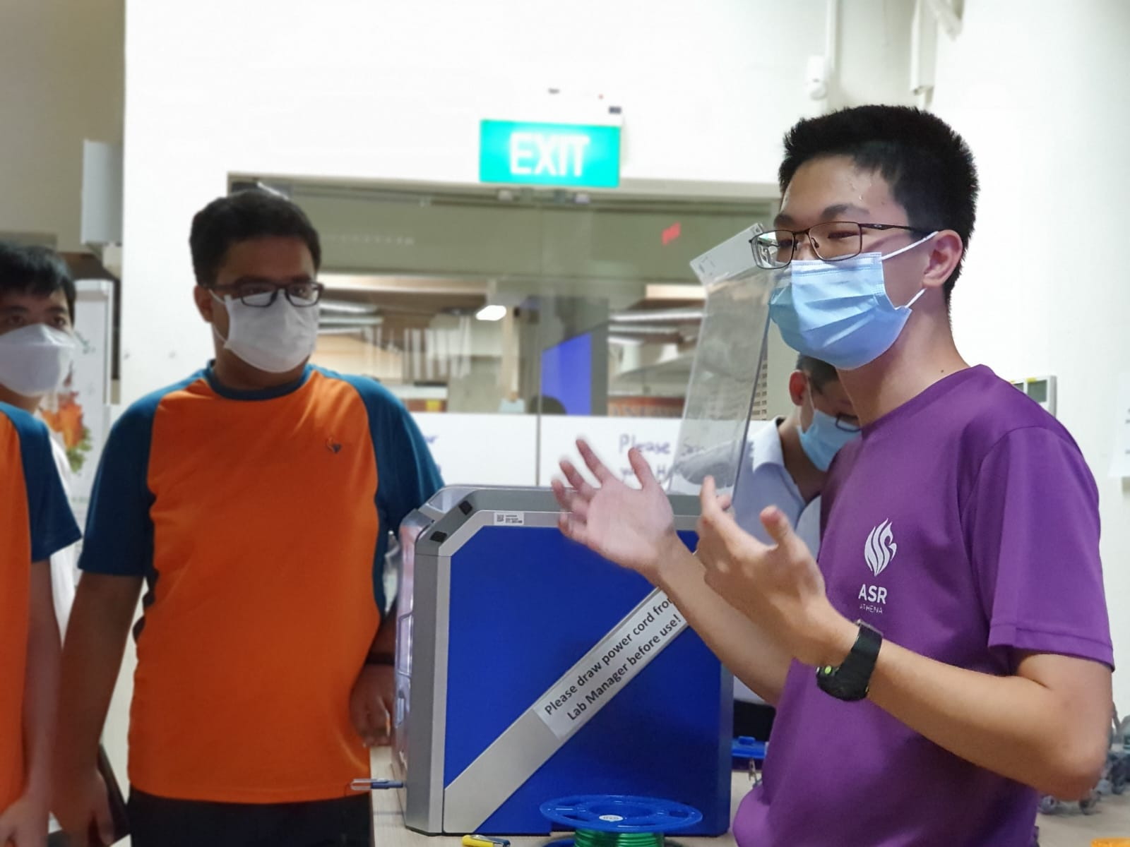
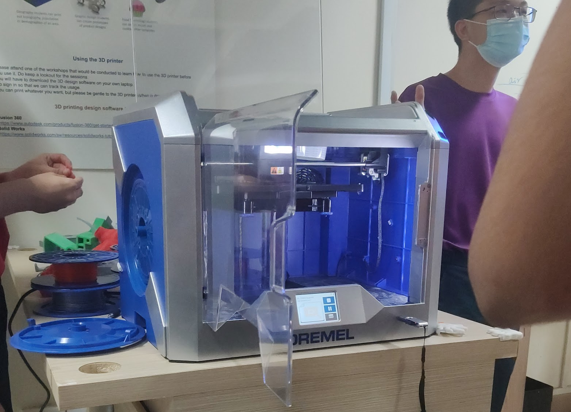
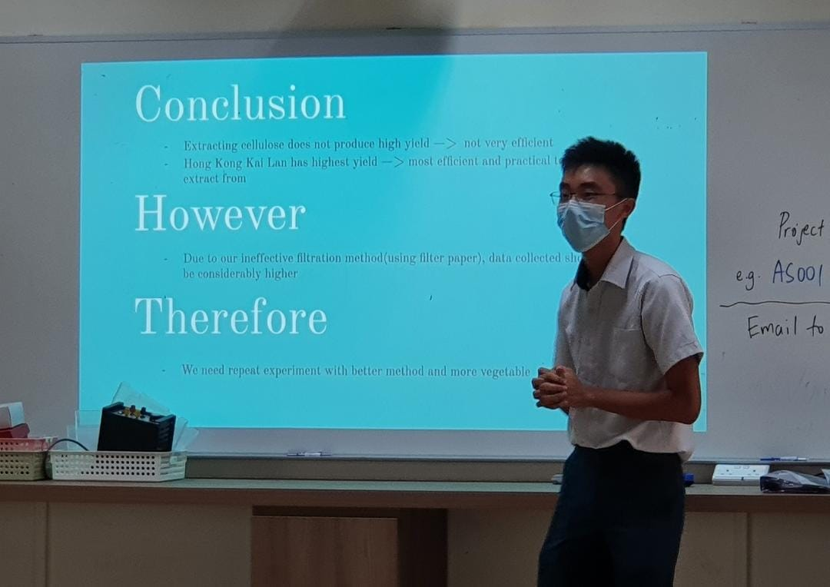
STEM Inc.
Wednesday & Friday
3.30 - 6.30
Notes:
Adhithyaa:
Talking points:
SSEF one award this year, institution of engineers singapore (IES) special award
ELEMENTZ fair 2022, 5 bronze
National Robotics Competition 2022, team that won 2nd in future innovators category
Engineering innovation challenge 2022, one team won merit
we have 3d printing machine, paper craft station, robotics,...
Javascript,css and html, python, C++ (arduino included)
our seniors provides us with workshops on the various equipments in the playpen and skills such as python, arduino
for preparation to International Elementz Fair & Singapore Science and Engineering Fair, we present our idea in front of everyone to gain feedbacks and inspirations
Introduction to Stem Inc. and its activities: (Note: ask for pictures from seniors)
Access to resources: the different corners of Playpen
Assistance in opportunities for STEM competition: mentors, seniors,...
Workshop: variety of science subjects, coding,... (ASRJC offers Computing and FMath)

Slide 29

SSEF: one award this year: institution of engineers singapore (IES) special award
Notes:
Adhithyaa:
Talking points:
SSEF one award this year, institution of engineers singapore (IES) special award
ELEMENTZ fair 2022, 5 bronze
National Robotics Competition 2022, team that won 2nd in future innovators category
Engineering innovation challenge 2022, one team won merit
we have 3d printing machine, paper craft station, robotics,...
Javascript,css and html, python, C++ (arduino included)
our seniors provides us with workshops on the various equipments in the playpen and skills such as python, arduino
for preparation to International Elementz Fair & Singapore Science and Engineering Fair, we present our idea in front of everyone to gain feedbacks and inspirations
Introduction to Stem Inc. and its activities: (Note: ask for pictures from seniors)
Access to resources: the different corners of Playpen
Assistance in opportunities for STEM competition: mentors, seniors,...
Workshop: variety of science subjects, coding,... (ASRJC offers Computing and FMath)

Slide 30
Our Story
Adhithyaa and Mai share their personal experience as an ASRJCian
Notes:
Adhithyaa’s Script:
Originally a bit scared of the differences between Secondary School and JC
Teachers are really nice and willing to answer questions.
STEM Inc. technology is amazing - it’s what drew me to ASR
Mai:
Experience as a Vietnamese student in Singapore - much more self-directed learning
Coping with stressful workload(friends - academically & mentally)
STEM Inc. provides numerous opportunities for scientific projects and competitions
For next slide: I, personally, have not had any wonderful scientific discovery myself. However, our seniors have spent the past year developing their own

Slide 31

Project Showcase by our JC2 Seniors
Extracting Cellulose from Commonly Consumed and Wasted Asian Vegetables
By Trevor, Dechun and Joe
Notes:
We will now invite our Year 2 seniors, Trevor, Dechun and Joe, to share about a research project that they have embarked on.
They have recently won a bronze medal at the Singapore Science and Engineering Fair (SSEF). Let us hear more about their research journey. We will now handover the time to them.

Slide 32
Q & A session

Slide 33
THE END
Notes:
That is all the time we have for today. On behalf of all ASRJC-ians, i would like to thank NTT high school for giving us the opportunity to learn more about the Vietnamese culture and your unique way of life and thank you for giving us the opportunity to share more about our lifestyle and Singapore’s heritage and culture. We hope you found this session just as fruitful and enjoyable as we did. Hope to see you soon, thank you everyone!

Slide 34
Elements
Resource
Page
Use these design resources
in your Presentation. Happy designing!
Don't forget to delete this page before presenting.

Slide 35
Icons
Resource
Page
c
Use these design resources
in your Presentation. Happy designing!
Don't forget to delete this page before presenting.

